Slide 1
P0 Presentation
Christian Romero

Slide 2
Functionality
place orders to store locations for customers
add a new customer
search customers by name
display details of an order
display all order history of a store location
display all order history of a customer
input validation
exception handling
persistent data (to a DB); no hardcoding of data.(prices, customers, order history, etc.)

Slide 3
Functionality
add a new customers
search customers by name
display details of an order
place orders to store locations for customers
display all order history of a store location
display all order history of a customer
input validation
exception handling
persistent data (to a DB); no hardcoding of data.(prices, customers, order history, etc.)

Slide 4
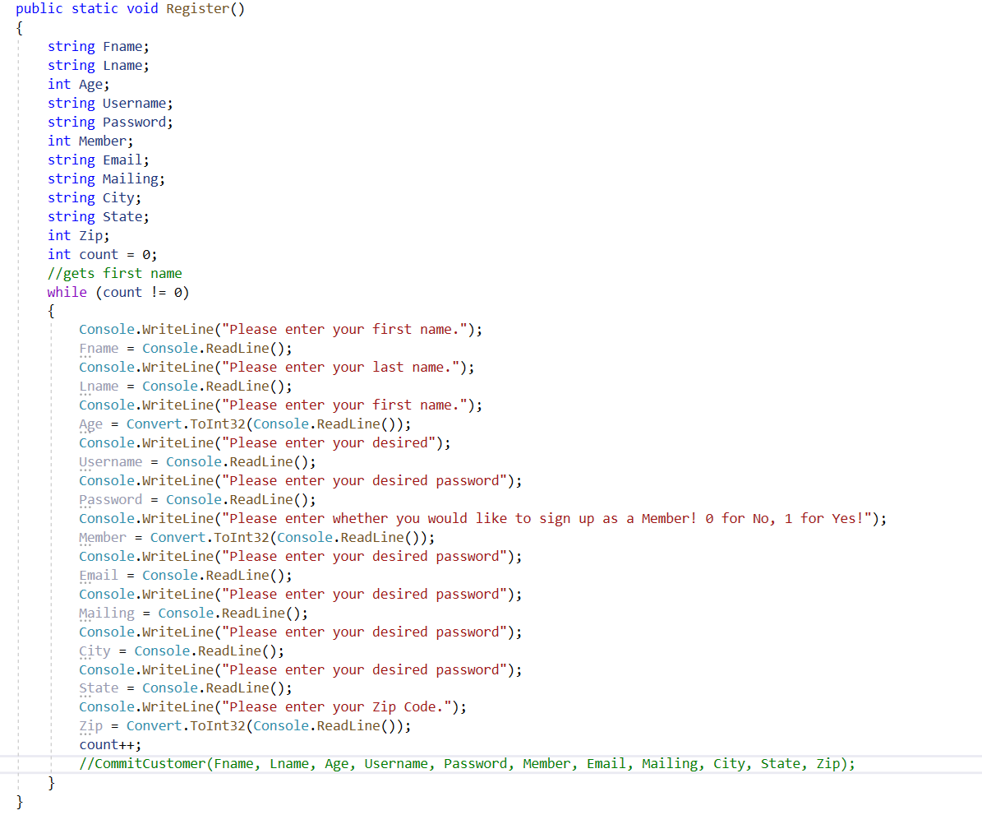
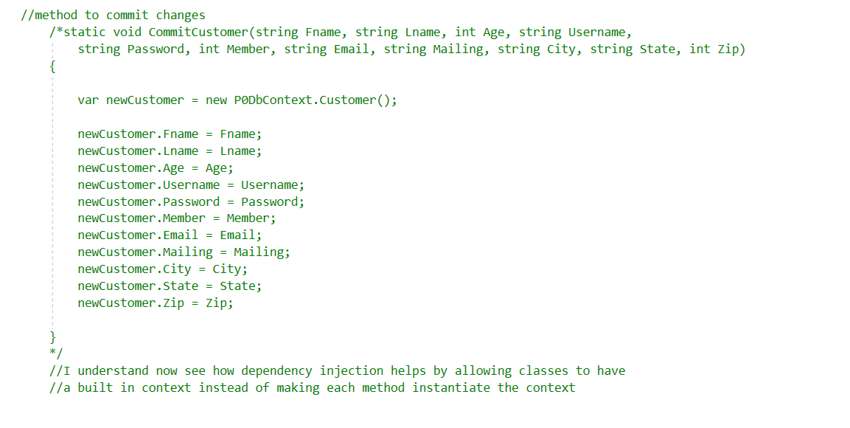
add a new customer

Slide 5
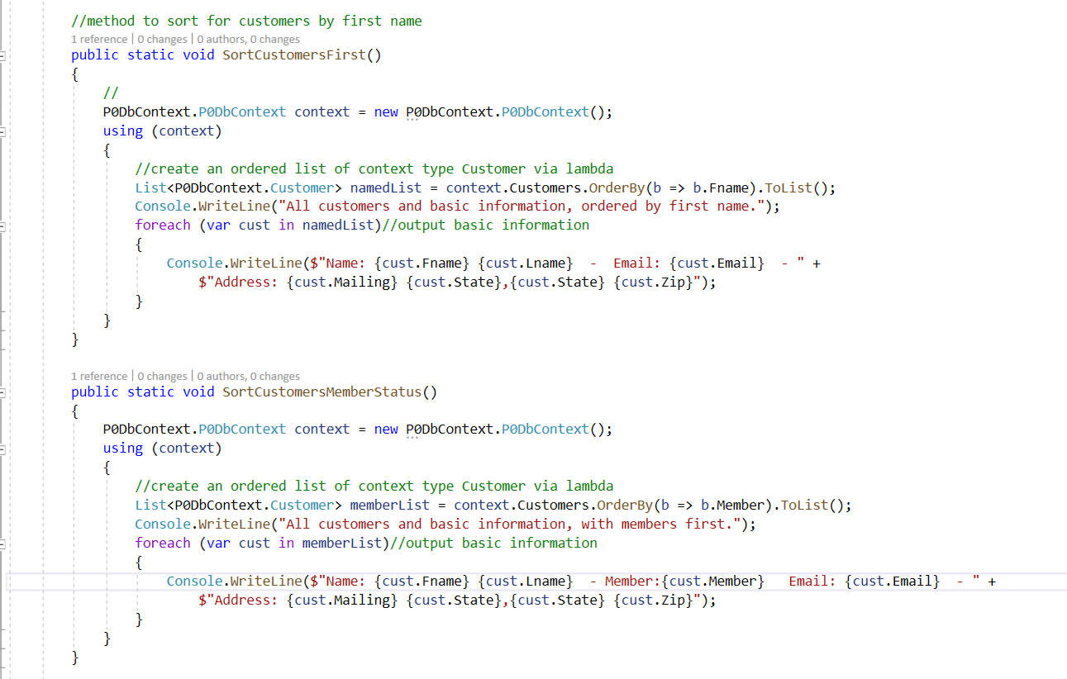
search customers by name (& other parameters)

Slide 6
display details of an order

Slide 7
place orders to store locations for customers

Slide 8
display all order history of a store location

Slide 9
display all order history of a customer

Slide 10
Data Access Class Library

Slide 11
Classes
Customer snip
Order Snip
Location snip
Product snip

